Slide 1

Team Vivaldi
Khadija, Marta, Jiang, Tobi, Thuvarahgan
Notes:
Jiang

Slide 2
Overview
Background/ Introduction
Software Architecture
Database Schema
Allele Frequencies, Manhattan plot, LD Calculations & Heatmap
Applications, Future Work & Limitations
Demo
Notes:
Jiang

Slide 3
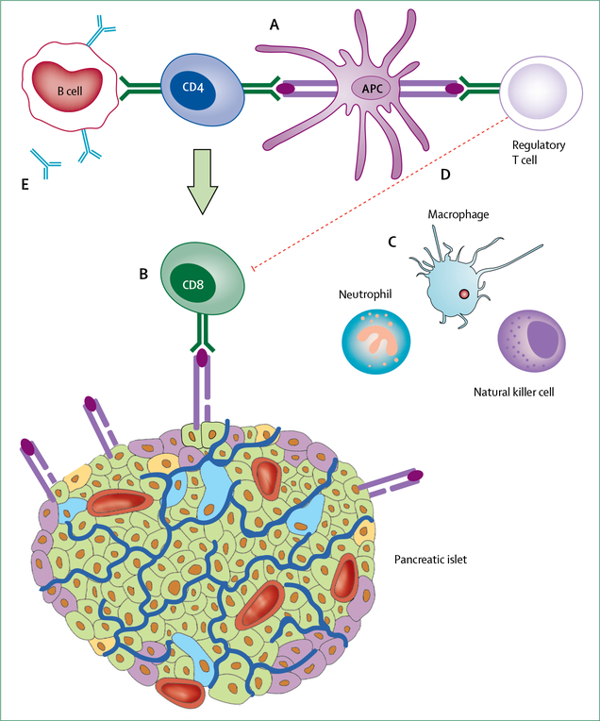
Type 1 diabetes SNP Search tool
Type 1 diabetes is a chronic autoimmune disorder in which the immune system attacks the pancreatic β cells which produce insulin.
Genome wide association studies have been able to identify SNPs which are associated with T1D.
There is also relevant genomic, functional and clinical information available about the SNPs.
The aim of this project is to produce a functioning web-based software tool that allows users to search and explore genetic variants that are associated with T1D. The website should be able to retrieve genetic information and integrate it with population data and functional information.
Notes:
Jiang
Goal of the project is to develop a web browser that leverages upon all the genomic, functional, clinical information available nowadays. (this is a quote from the project briefing)
The aim of the project is to build a web application that can retrieve genomic information of variants from all known associations to T1D and integrate them with population and functional information. It should also be capable to produce informative plots and analyses in this regard. (another quote)

Slide 4
Notes:
Jiang

Slide 5
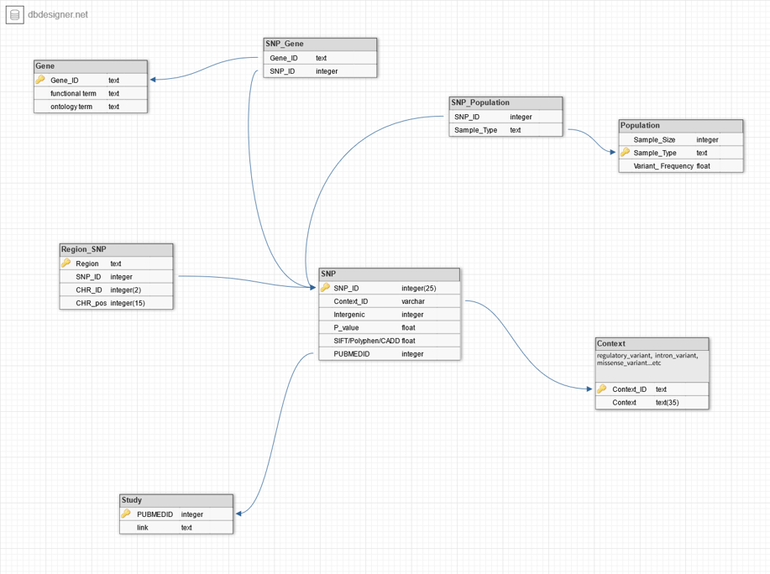
DATABASE Schema
Data Storage
Schema Design Considerations
Data Import
Notes:
Jiang

Slide 6
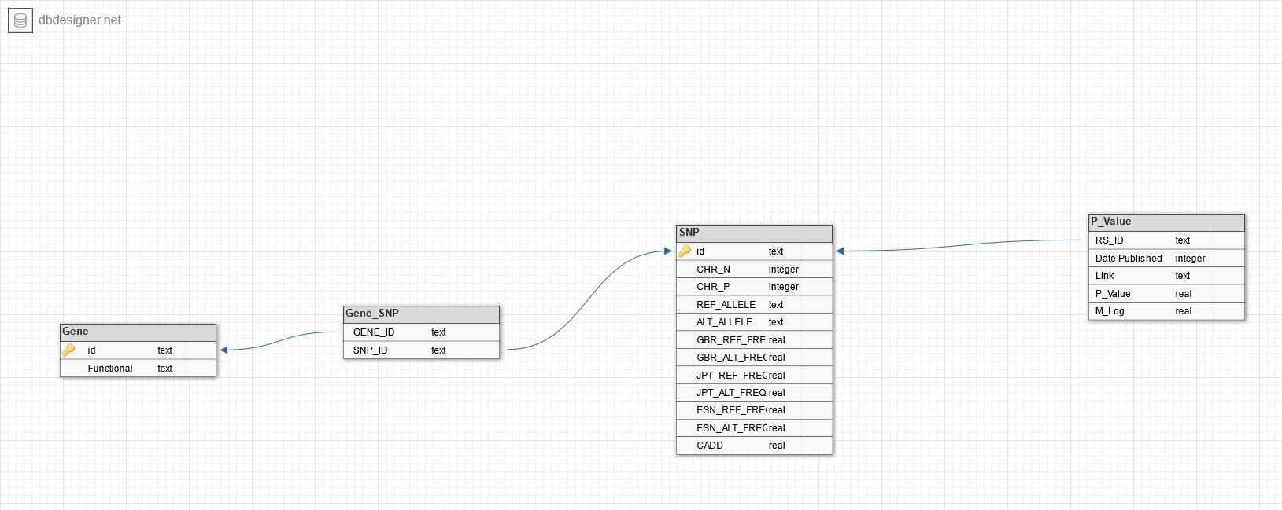
Notes:
Jiang

Slide 7
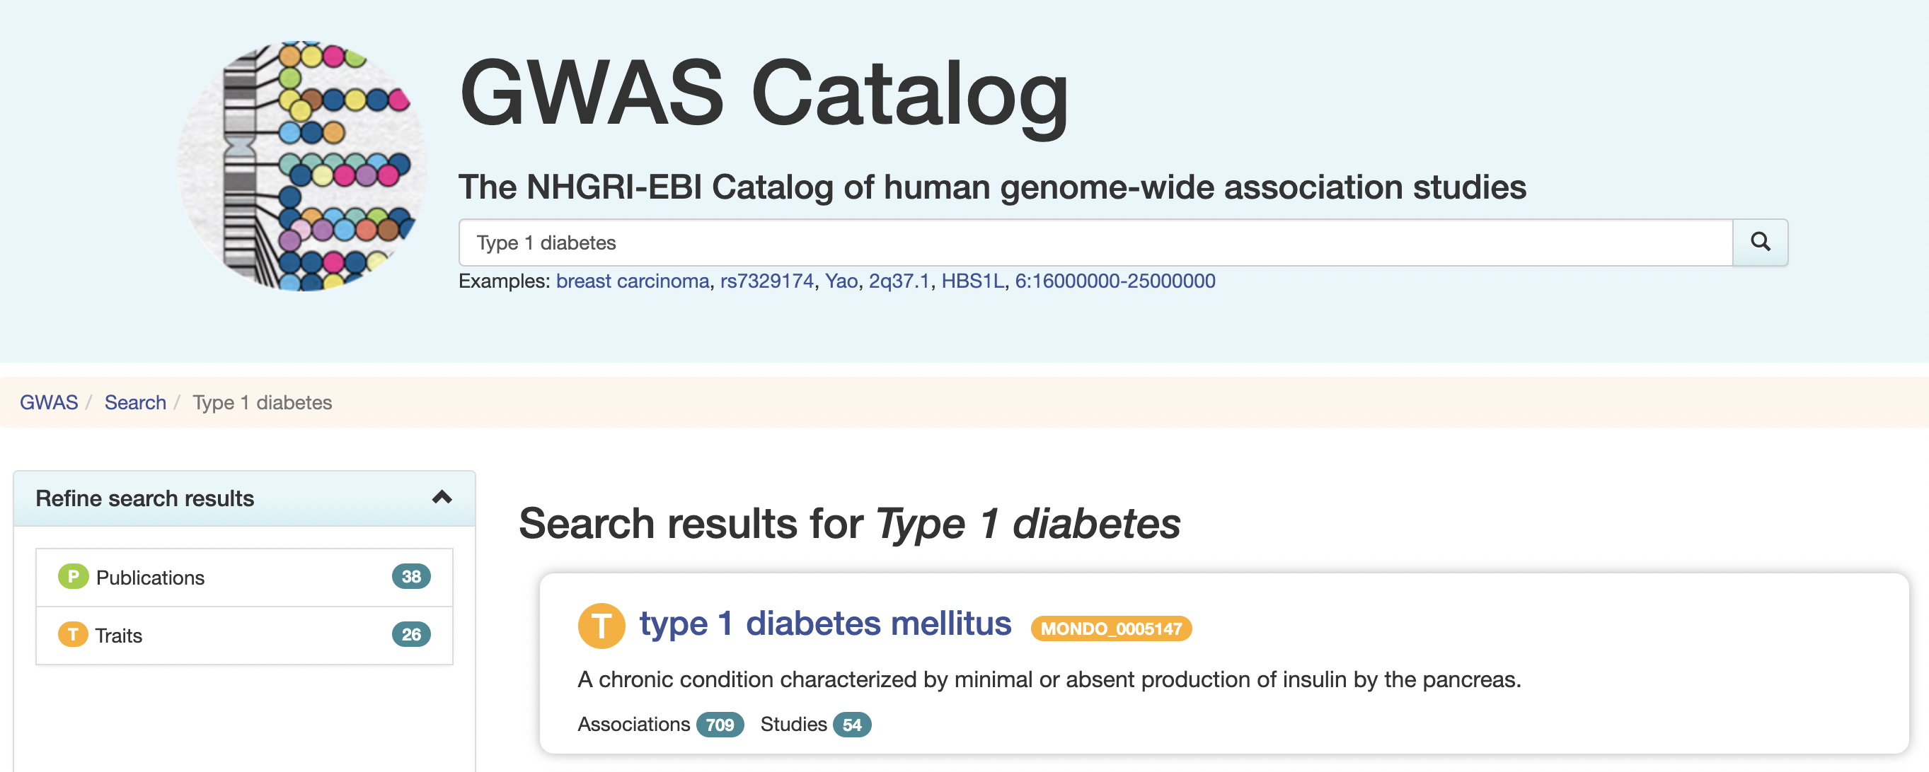
GWAS data
Notes:
Tobi
GWAS shows all known SNPs from primary GWAS studies older than 2 months
Search for all rsids for variant and risk alleles associated w/type 1
Pvalue and chromosome position
Data was obtained as a tsv from the GWAS catalog for whole genome

Slide 8
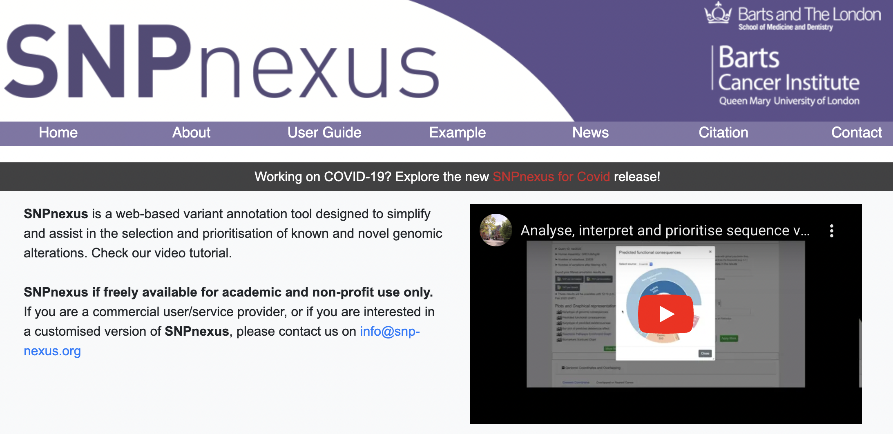
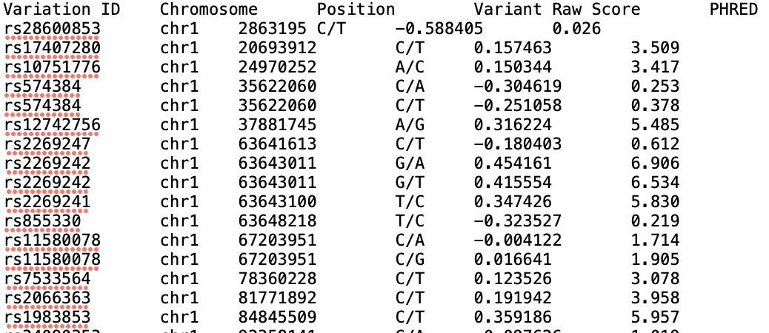

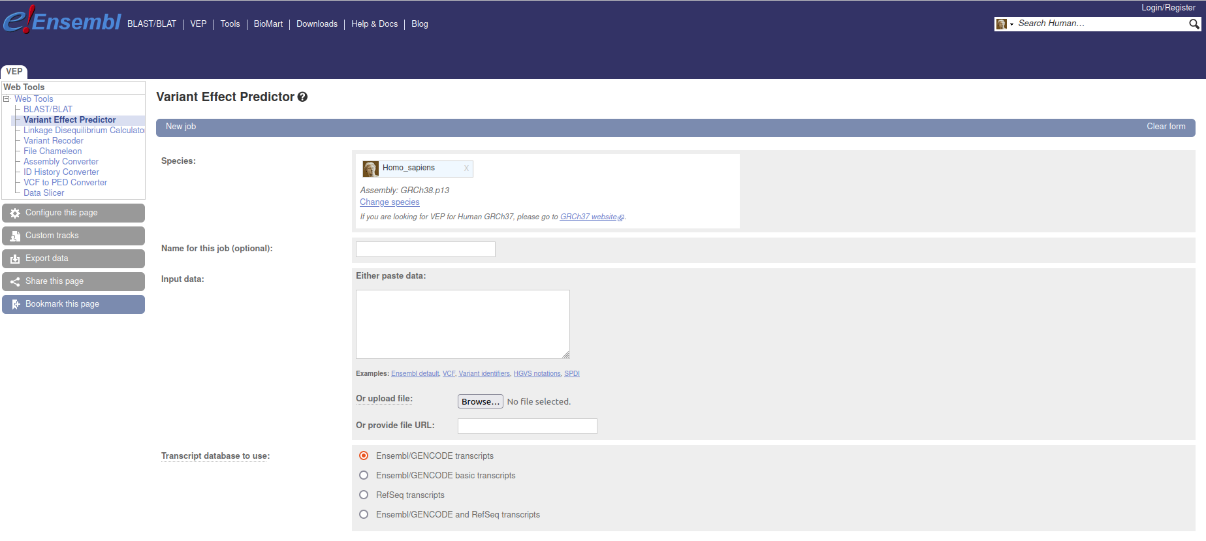
Functional impact of SNPs
SNP nexus
Ensembl
CADD RAW + CADD PHRED
Notes:
Tobi
W/this tsv the full list of snps was searched via SNP nexus- information needed for our final database coming from 2 primary databases
The first being Ensmbl – gave us p values
And variety of measures of functional impact of the SNPs
CADD PHRED our chosen measurement
CADD (Combined Annotation Dependent Depletion) is a score that integrates multiple genomic annotations and conservation into a ml algorithm to predict the deleteriousness of genetic variants.
CADD Phred is a normalized and transformed version of the CADD score that ranges from 0 to 99, where higher scores indicate greater deleteriousness of the genetic variant.(done by ranking all known snps and put them on that scale)

Slide 9
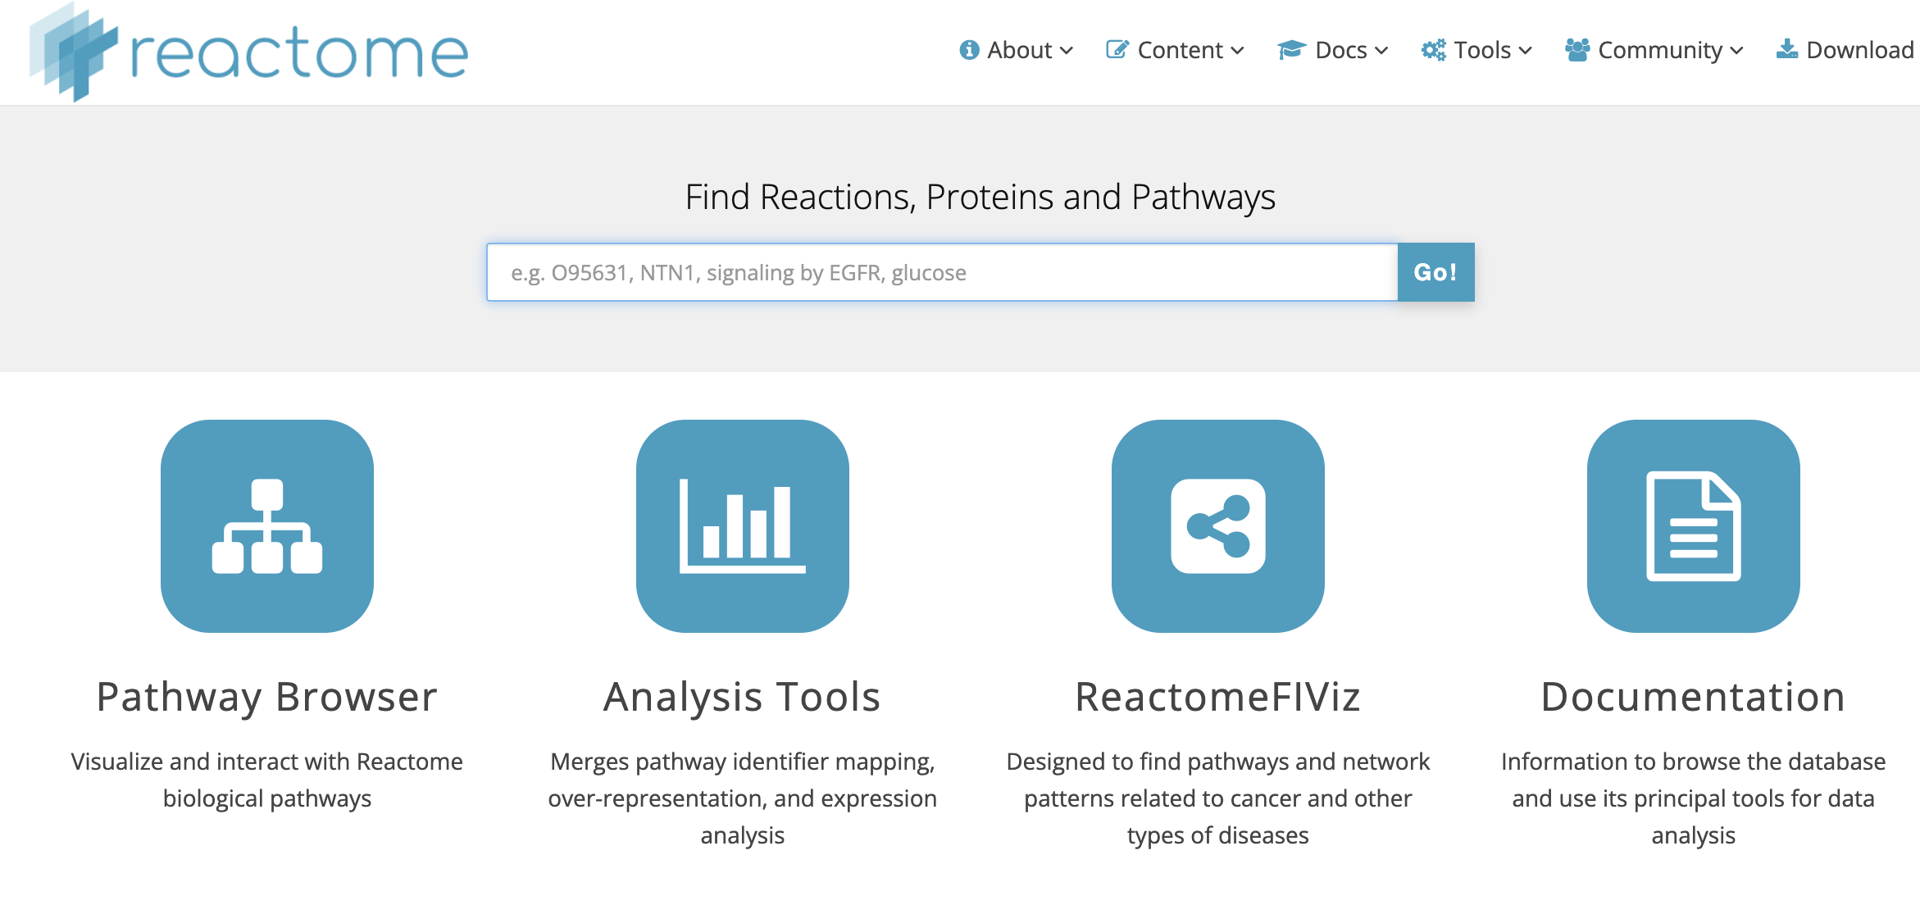
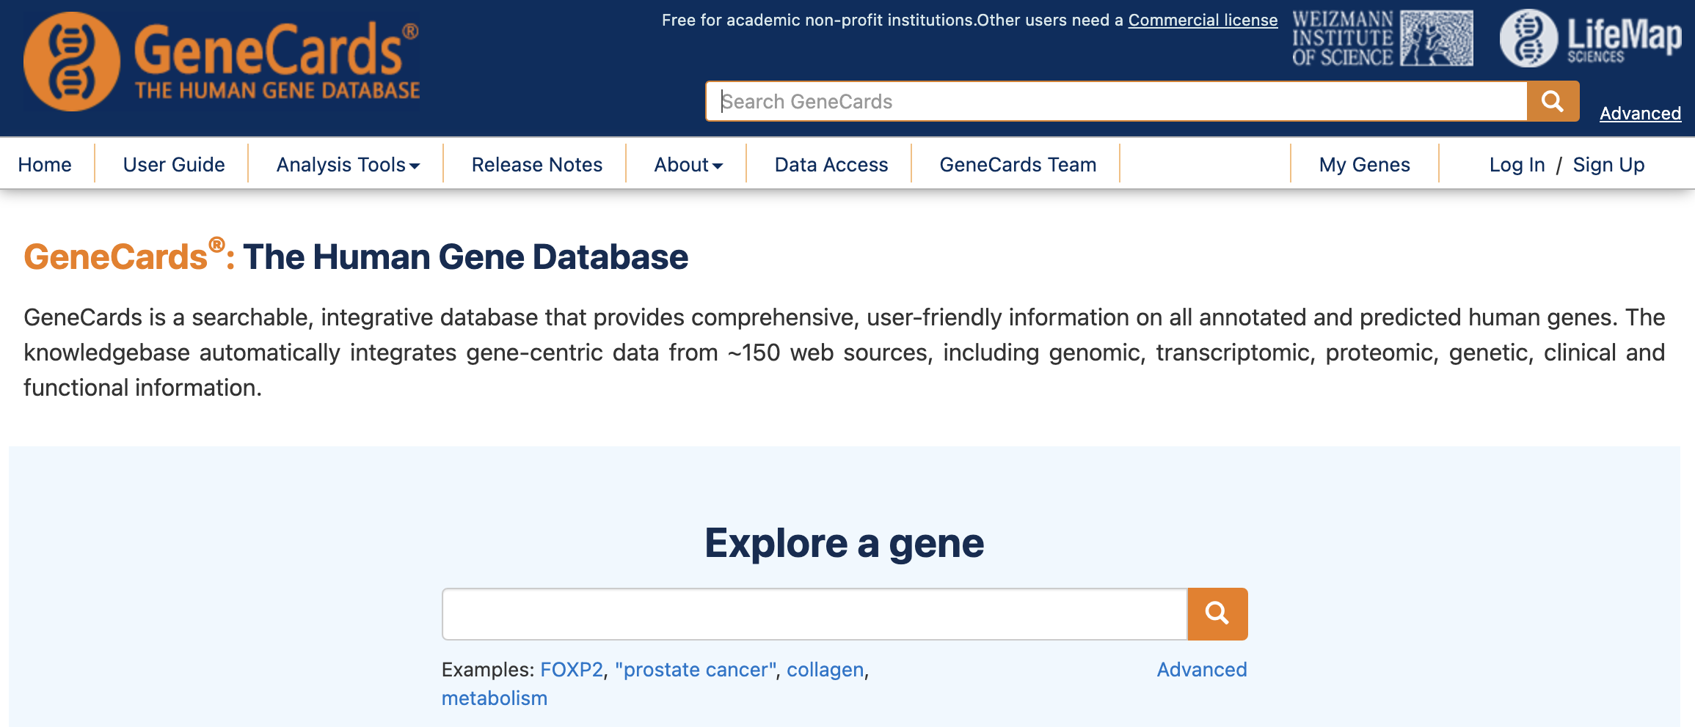
gene functional terms
SNP nexus
Reactome
Mapped gene + gene function
Gene Cards
Notes:
Tobi
The second being the recatome database- giving us SNP/gene functional terms i.e the function of the genes where SNPs are located and the pathways they are part of
Such as ligand binding or more general such as immune sytem

Slide 10
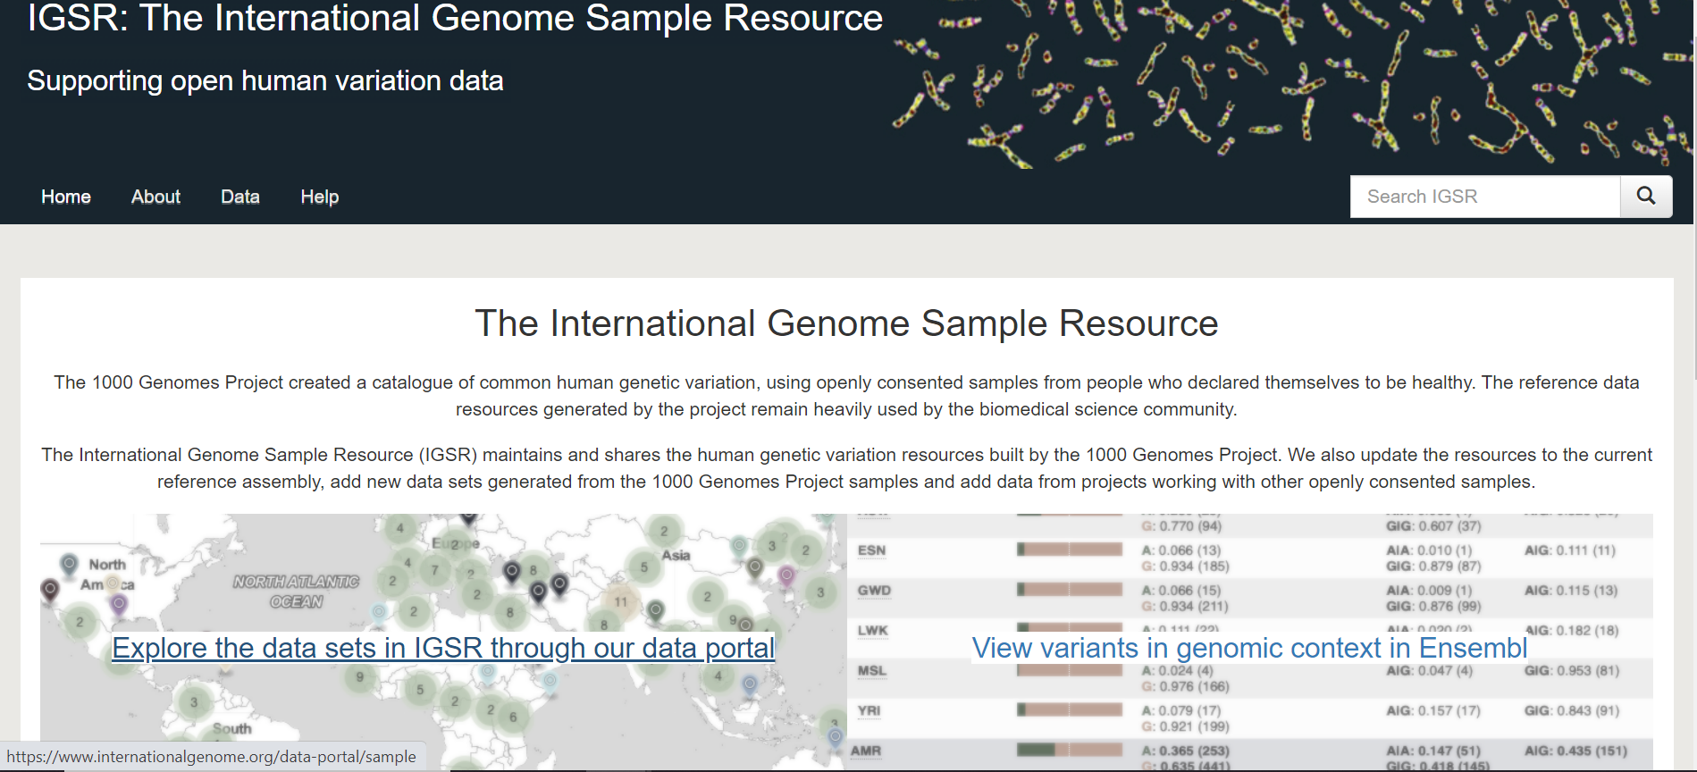
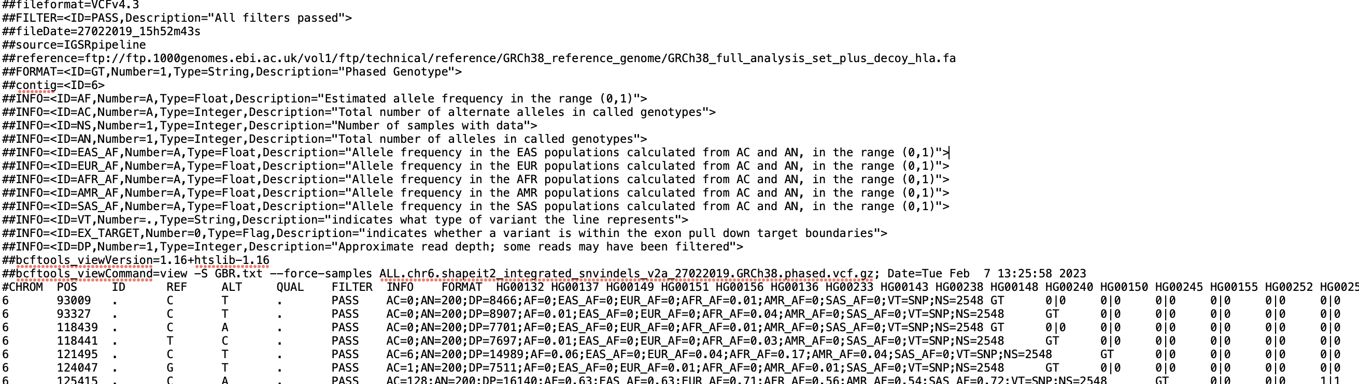
Calculating allele frequencies
Notes:
Thuvarahgan

Slide 11
Calculating allele frequencies
Raw VCF File
Filtered VCF File
Python Function
def Allele_Frequency(filename, output):
Notes:
Thuvarahgan

Slide 12
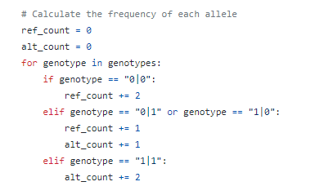
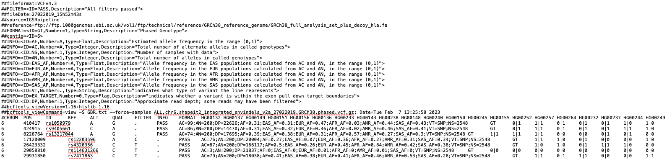
Calculating allele frequencies
Notes:
Thuvarahgan

Slide 13
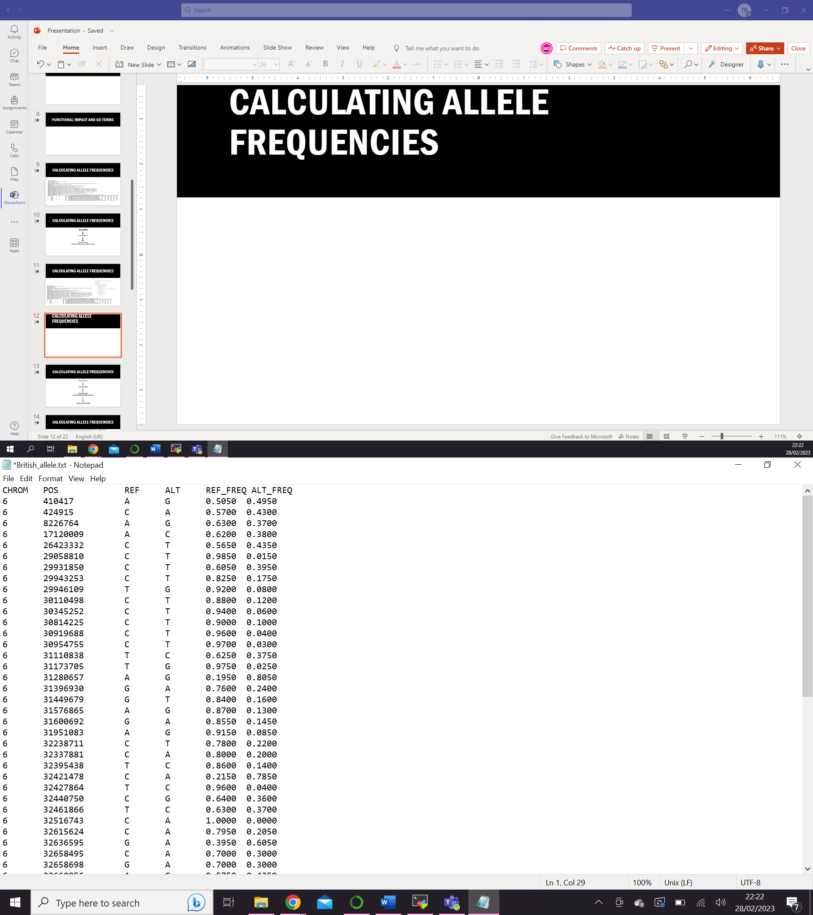
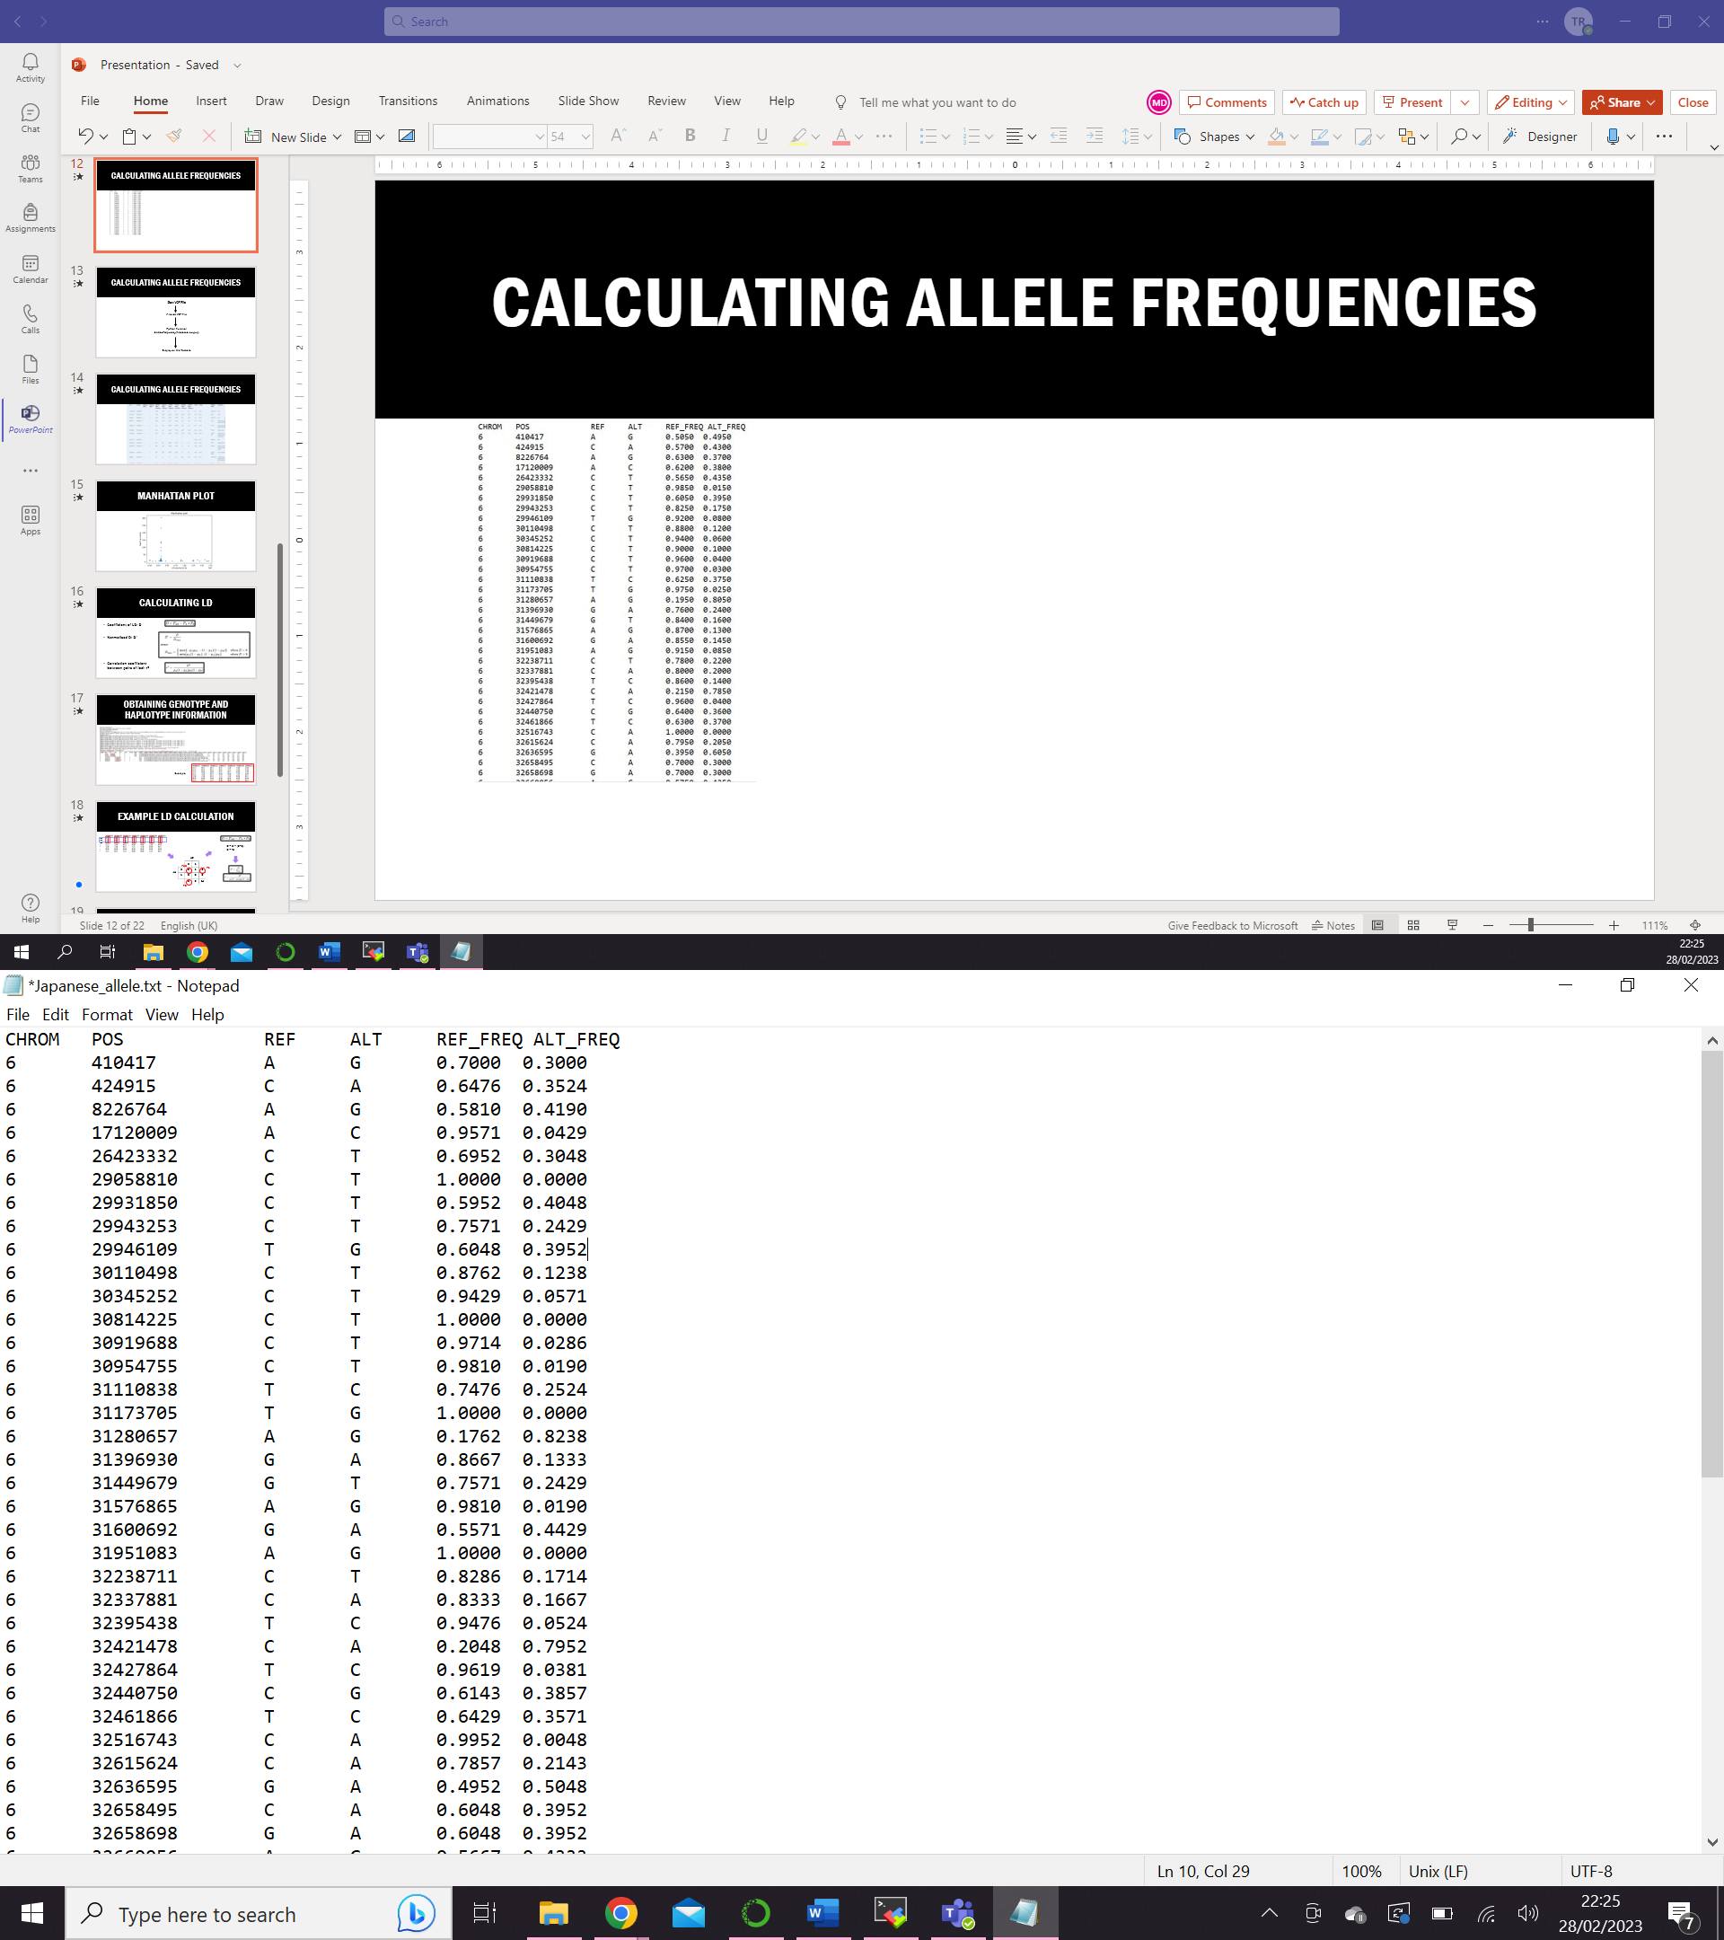
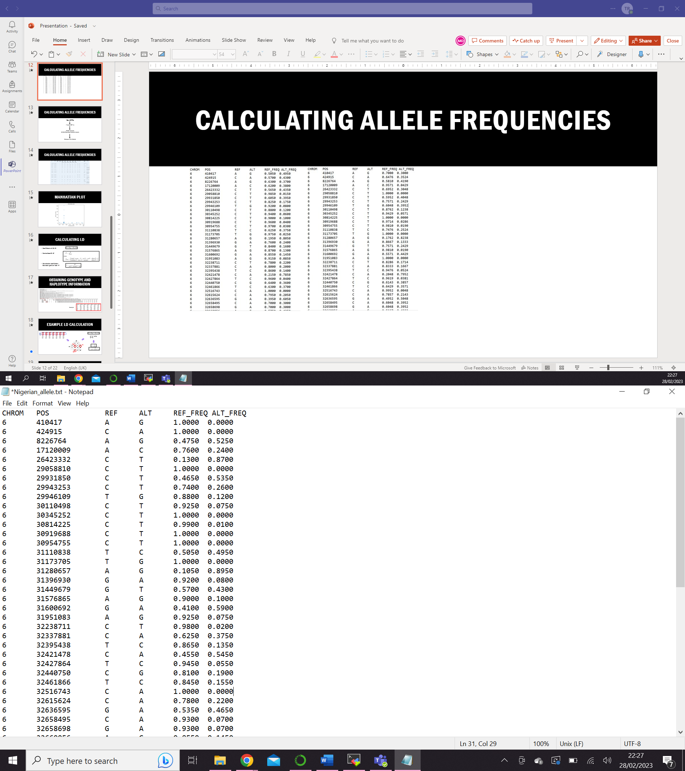
Calculating allele frequencies
British
Japanese
Nigerian
Notes:
Thuvarahgan

Slide 14
Calculating allele frequencies
Raw VCF File
Filtered VCF File
Python Function
def Allele_Frequency(filename, output):
Import to SQL Database
Notes:
Thuvarahgan

Slide 15
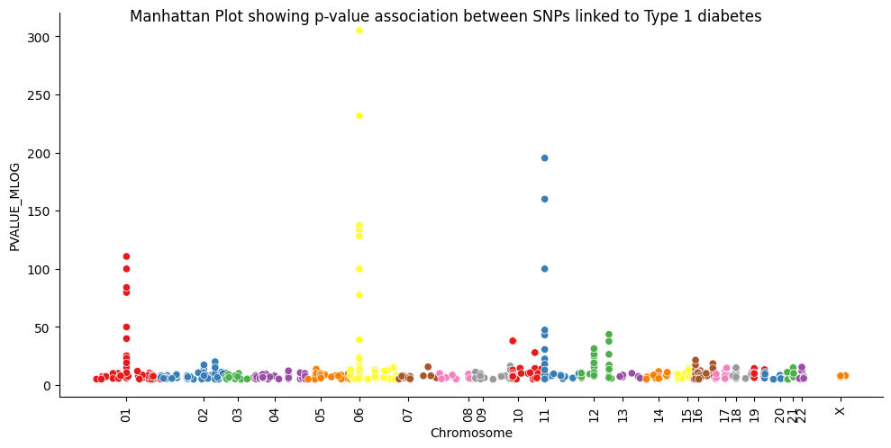
Manhattan plot
Notes:
Thuvarahgan

Slide 16
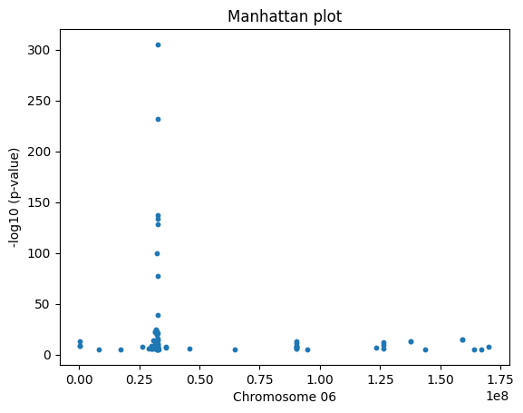
Manhattan plot
Chromosome number
Chromosome position
rsID
P-value
Data Frame
Notes:
Thuvarahgan

Slide 17
Obtaining genotype and haplotype information
Notes:
Marta
Steps
In order to calculate the coefficient of LD, we needed to determine the frequencies of PA, PB, PAB. For this, we used the genotype data from the VCF population files obtained from IGSR.
We then created three sqlite database for this information, 1 per population. Each database is structured as 1 table per SNP, or rs ID.
So when the user inputs the rs IDs they want to calculate LD for, the software obtains the genotype data from the database on demand.

Slide 18
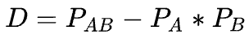
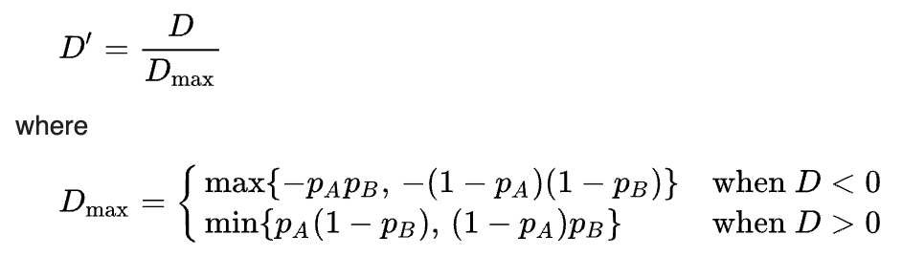
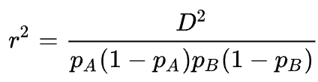
Calculating lD
Coefficient of LD:
Normalised coefficient:
Correlation coefficient between pairs of loci:
Notes:
Marta
In order to calculate the LD measures for our SNPs, we tried looking for python tools that I could use, but I had no luck
So we decided to write own scripts.
In literature, the two common measures of LD that are used to represent LD are D’ (the normalized coefficient) and r2 (the correlation coefficient). so in order to calculate them, our script first has to calculate the D, which is the coefficient of LD.

Slide 19
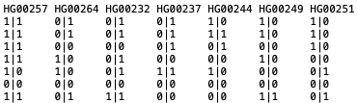
Example LD calculation
rs1
rs2
rs3
.
.
.
.
PA = 0.43
PB = 0.36
PAB = 0.36
D = 0.36 – (0.43*0.36)
D = 0.21
 |  | rs2
 |  | 0 | 1
rs1 | 0 | 5 | 1 | 6
 | 1 | 0 | 8 | 8
 |  | 5 | 9 | 14
PAB = 5/14
PA = 6/14
total haplotypes
PB = 5/14
Notes:
Marta
Now I want to show a very basic example of how our code calculates the frequencies for the LD equations.
Here I have a screenshot of the genotypes for 7 individuals of a population. LD is calculated for pairs of SNPs, so in this example Iwill calculate LD for the first two rows of SNPS
Then I look at each individuals haplotypes, in each of their chromosome. What they have on one chromosome is considered one haplotype.
Then I count the number of types of haplotypes. ‘00’ means that individual has a reference allele at rsID1 and reference allele at rsID2. A ‘11’ haplotype means that individual has an alternate allele at rsID1 and an alternate allele at rsID2. A haplotypes of ‘01’ and ‘10’
Then, the sum of the ‘00’ and ’01’ haplotypes is divided by the total haplotype number, in this case 14. This is frequency of pA
The sum of the ‘00’ and ‘10’ divided by the total haplotypes is the frequency of pB
And PAB is the number of ‘00’ divided by the total.
Obtained the vcf files of the chr6 only.
Filled in the rs ID column.
Created a database for the rs ID + genotype information. 1 database per population. Each database has 1 table per rs ID.
once the user has selected the rs IDs it wants to calculate LD for, the script will go through one pair at a time.
Heres an example. The user has chosen rsID 1 and rs ID 2.
The script obtains the genotypes for those rs IDs in the database, and temporarily stores them as dictionaries.
Next, it goes to look at only the 1s and 0s.
Then it compares the digit from that location in both rs ID genotypes. For example, individual HG00257 has a 1 and a 1 on the left chromosome. This means that on that chromosome, it has the alternate allele. On the right chromosome, this individual also has 1s on both loci.
then the script does this for all individuals, on both chromosomes. And counts the number of types of haplotypes it finds.

Slide 20
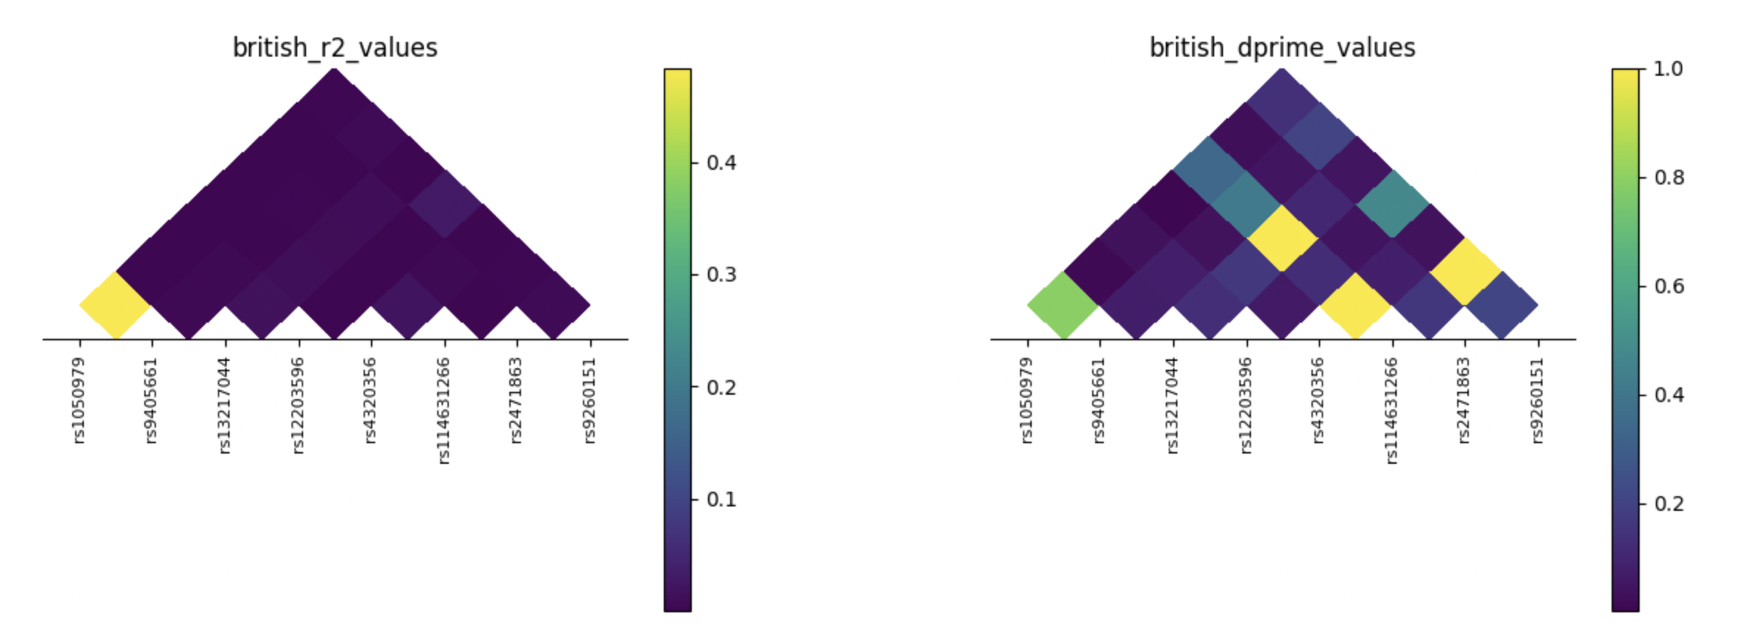
Example ld heatmaps
Notes:
Marta
Example r2 and D’

Slide 21
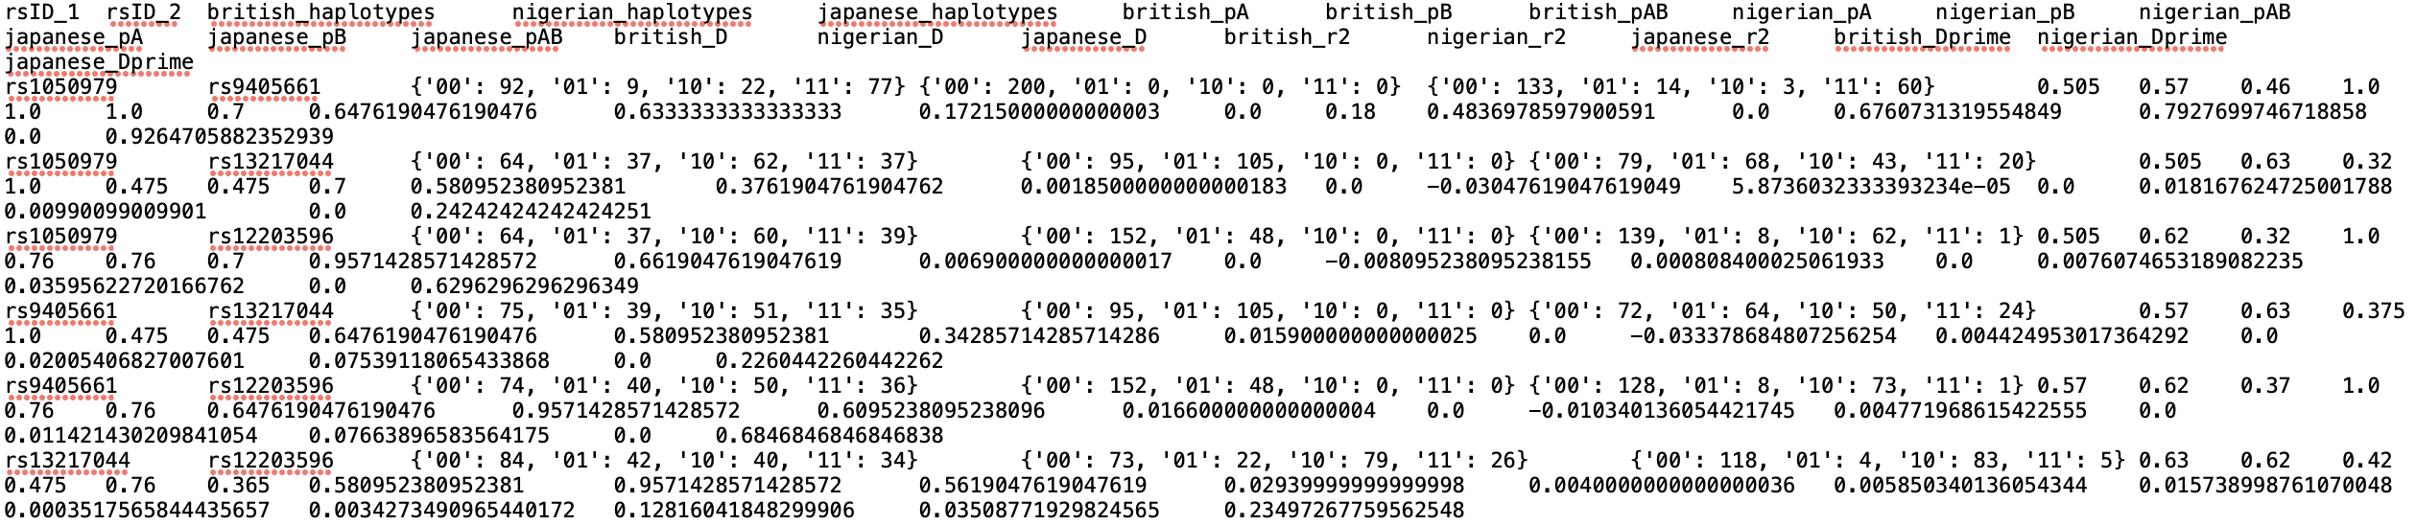
example txt output file
rsID_1 | rsID_2 | british_haplotypes | british_pA | british_pB | british_pAB | british_D | british_r2 | british_Dprime
rs1050979 | rs9405661 | {'00': 92, '01': 9, '10': 22, '11': 77} | 0.505 | 0.57 | 0.46 | 0.17215 | 0.48369786 | 0.792769975
rs1050979 | rs13217044 | {'00': 64, '01': 37, '10': 62, '11': 37} | 0.505 | 0.63 | 0.32 | 0.00185 | 5.87E-05 | 0.00990099
rs1050979 | rs12203596 | {'00': 64, '01': 37, '10': 60, '11': 39} | 0.505 | 0.62 | 0.32 | 0.0069 | 0.0008084 | 0.035956227
rs9405661 | rs13217044 | {'00': 75, '01': 39, '10': 51, '11': 35} | 0.57 | 0.63 | 0.375 | 0.0159 | 0.00442495 | 0.075391181
rs9405661 | rs12203596 | {'00': 74, '01': 40, '10': 50, '11': 36} | 0.57 | 0.62 | 0.37 | 0.0166 | 0.00477197 | 0.076638966
rs13217044 | rs12203596 | {'00': 84, '01': 42, '10': 40, '11': 34} | 0.63 | 0.62 | 0.42 | 0.0294 | 0.015739 | 0.128160418
Notes:
Marta

Slide 22
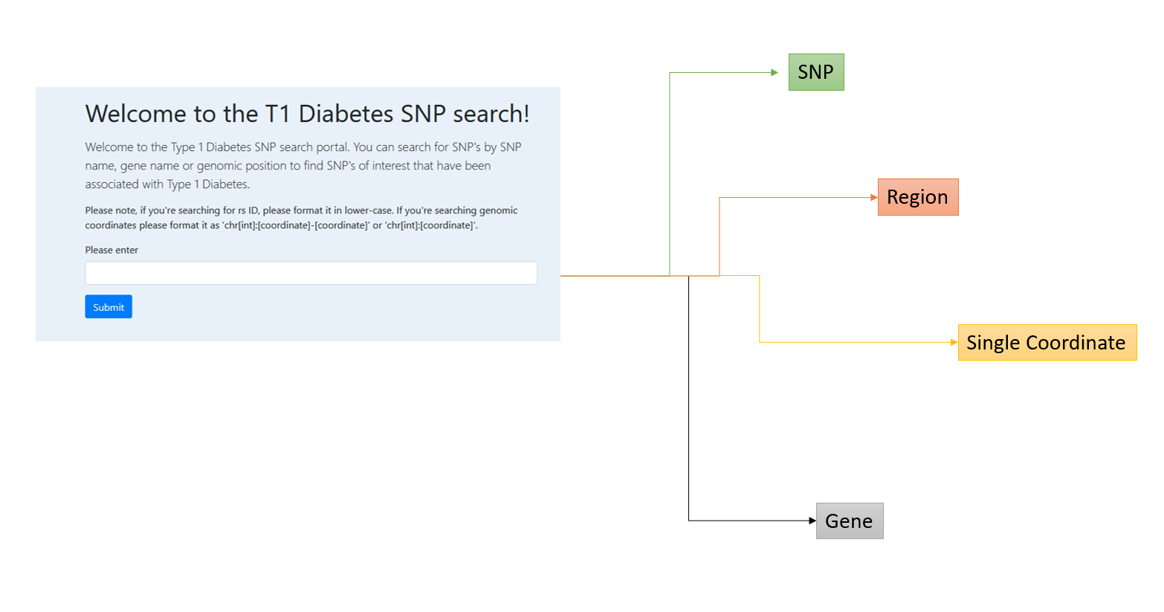
SEARCHING THE Database
The routes from the search bar​
Accepted inputs and their formats​
Layout of results
Notes:
Jiang
Jiang briefly explains the main search page. This leads into Khadija's demo of the website.

Slide 23
Demo
Time for a walkthrough of the website!
Notes:
Khadija

Slide 24

limitations
Search bar detection can be further optimised.
Selection of rsIDs for LD is could be more user-friendly.
Manhattan plot could be better optimised for user viewing and more interactive.
Our software maybe be at risk from SQL injection attacks.

Slide 25
Applications & Future works
Tool for researchers
Clinical care
Educating students on T1D
Drug Development

Slide 26
Thank you!
Any Questions?

